Slide 1

LEADERS’ MEETING

Slide 2
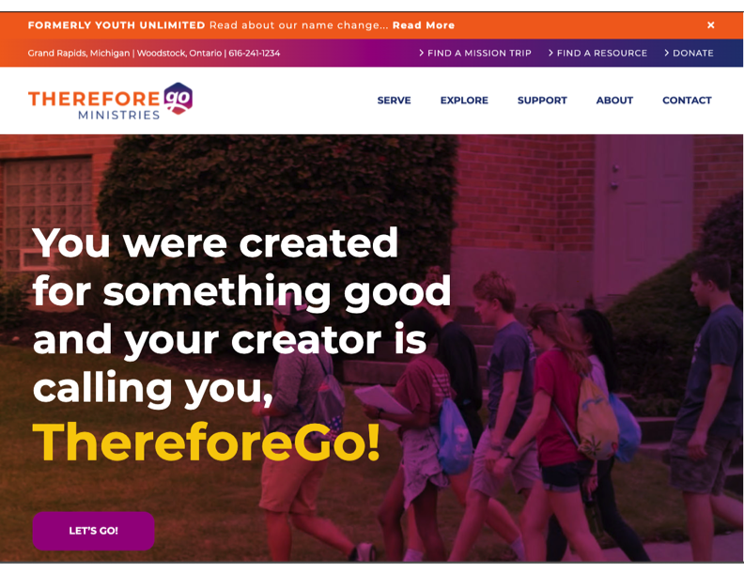
For more information and details:
ThereforeGo.com

Slide 3
THEREFOREGO Mission Statement
Helps churches challenge youth and emerging adults to commit their lives to Jesus Christ and
transform this world for him.

Slide 4
Serve is structured to emphasize:
Opportunities to worship
Pursuing a deeper walk with God
Revealing God-given strengths
Opportunities to serve
Showing a broken world in need
Strengthening adult & student relationships

Slide 5
Restoring a Broken World
Community Revitalization
Compassion for the Marginalized
Creation Care
Recreational Ministry for Children
Acts of Kindness Leading to Evangelism

Slide 6
Impact On Our Students – Growing IN:
  Thankfulness
  Generosity
  Prayer
  Justice
  Investigation of their strengths
  Wrestling with current life issues

Slide 7
Adult Responsibilities (Handouts)
Covenant for Participants
Adult Responsibilities
Building Relationships
Serving Safely
Leading Small Groups
  All of these documents and more can be found in the Digital
  Resource Box on the ThereforeGo Ministries website.

Slide 8
YOU
were
made
for this!

