Slide 1

Parent Meeting

Slide 2


Slide 3
Mission Statement:
ThereforeGo Ministries helps churches challenge youth and emerging adults to commit their lives to Jesus Christ and transform this world for him.

Slide 4
SERVE is structured to emphasize:
Opportunities to worship
Pursuing a deeper walk with God
Revealing God-given strengths
Opportunities to serve
Showing a broken world in need
Strengthening adult & student relationships

Slide 5
Restoring a Broken World
Community Revitalization
Compassion for the Marginalized
Creation Care
Recreational Ministry for Children
Acts of Kindness Leading to Evangelism

Slide 6
Impact On Our Students – Growing IN:
  Thankfulness
  Generosity
  Prayer
  Justice
  Investigation of their strengths
  Wrestling with current life issues

Slide 7
Registration information
The cost for our SERVE trip will be $_____
There are scholarships available through ThereforeGo Ministries.
We will need to complete our online paperwork before April 1st or there will be a $50 late fee.
We will need to have one adult to every five students (including at least one of each gender) and each adult will need to complete a background check.

Slide 8
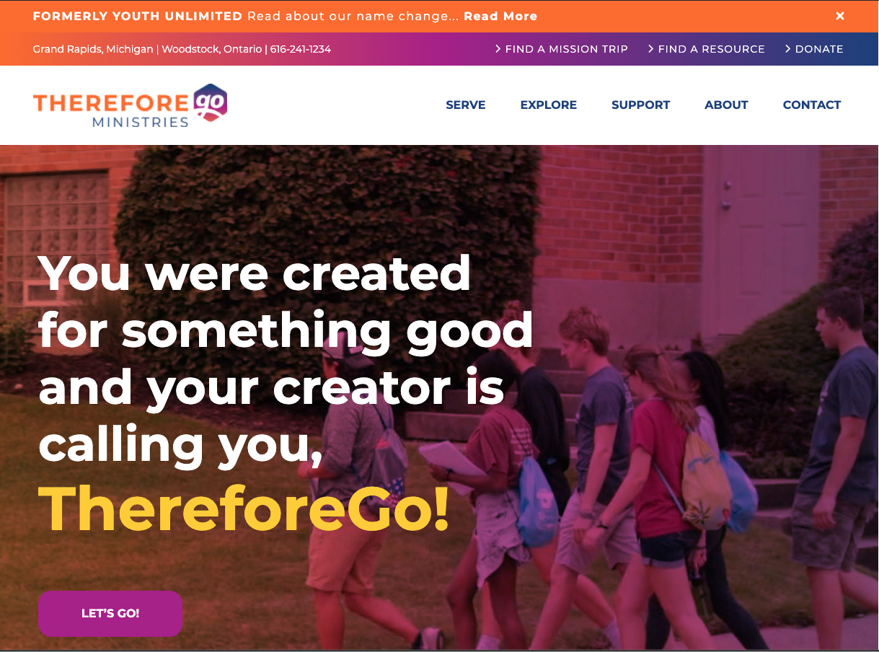
For more information and details:
ThereforeGo.com

Slide 9


