Slide 1

Parent Meeting

Slide 2


Slide 3
Mission Statement:
ThereforeGo Ministries helps churches challenge youth and emerging adults to commit their lives to Jesus Christ and transform this world for him.

Slide 4
SERVE is structured to emphasize:
Opportunities to worship
Pursuing a deeper walk with God
Revealing God-given strengths
Opportunities to serve
Showing a broken world in need
Strengthening adult & student relationships

Slide 5
Restoring a Broken World
Community Revitalization
Compassion for the Marginalized
Creation Care
Recreational Ministry for Children
Acts of Kindness Leading to Evangelism

Slide 6
Impact On Our Students – Growing IN:
  Thankfulness
  Generosity
  Prayer
  Justice
  Investigation of their strengths
  Wrestling with current life issues

Slide 7
Registration information
The cost for our SERVE trip will be $_____
There are scholarships available through ThereforeGo Ministries.
We will need to complete our online paperwork before April 1st or there will be a late fee. $25 late fee for registrations in on April 2 through April 15. $50 late fee for registrations in after April 15
We will need to have one adult to every five students (including at least one of each gender) and each adult will need to complete a background check.

Slide 8
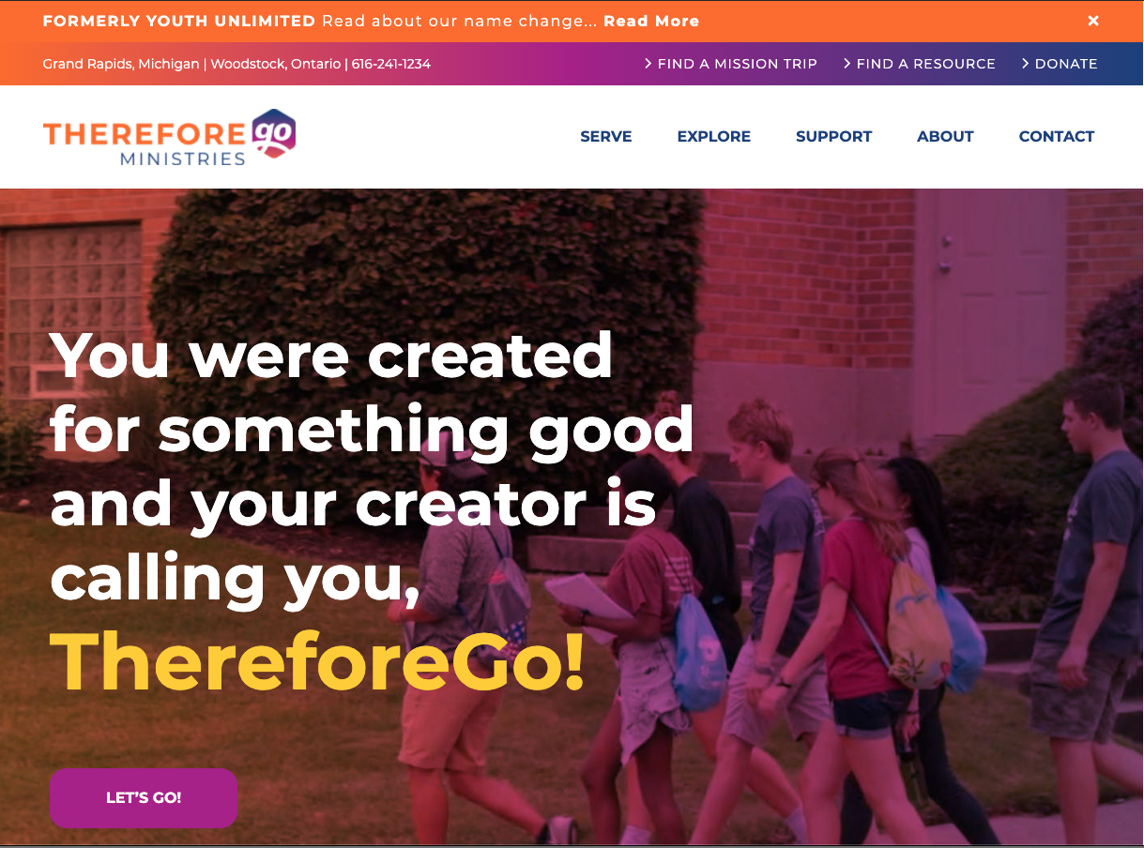
For more information and details:
ThereforeGo.com

Slide 9


